Slide 1
Automate a business process using Power Automate
Notes:
Link: https://docs.microsoft.com/en-us/learn/modules/flow-get-started/

Slide 2
Agenda
Get started with Power Automate
Use the admin center to manage environments and data policies
Introduction to business process flows with Power Automate
Create an immersive business process flow in Power Automate
Introduction to Power Automate security and governance

Slide 3

Get started with Power Automate

Slide 4
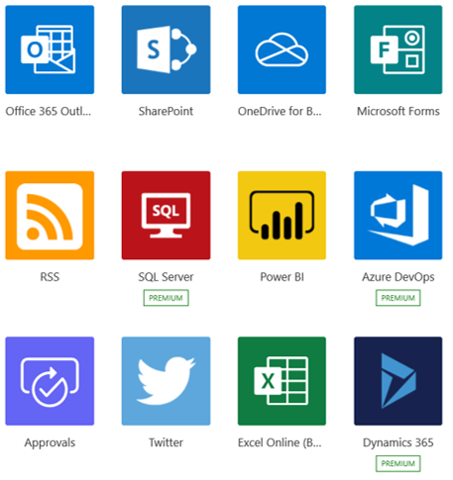
What is Power Automate?
Power Automate is an online workflow service that automates actions across the most common apps and services
Notes:
Power Automate is an online workflow service that automates actions across the most common apps and services. For example, you can create a flow that adds a lead to Microsoft Dynamics 365 and a row in MailChimp whenever someone with more than 100 followers tweets about your company.
When you sign up, you can connect to more than 220 services, and can manage data either in the cloud or in on-premises sources like SharePoint and Microsoft SQL Server. The list of applications you can use with Power Automate grows constantly.

Slide 5
What can you do with Power Automate?
Use Power Automate to automate workflows between your favorite applications and services, sync files, get notifications, collect data, and much more
For example, you can automate these tasks:
Instantly respond to high-priority notifications or emails
Capture, track, and follow up with new sales leads
Copy all email attachments to your OneDrive for Business account
Collect data about your business, and share that information with your team
Automate approval workflows
Notes:
You can use Power Automate to automate workflows between your favorite applications and services, sync files, get notifications, collect data, and much more.
For example, you can automate these tasks:
Instantly respond to high-priority notifications or emails.
Capture, track, and follow up with new sales leads.
Copy all email attachments to your OneDrive for Business account.
Collect data about your business, and share that information with your team.
Automate approval workflows.
A common use of Power Automate is to receive notifications. For example, you can instantly receive an email or a push notification on your phone whenever a sales lead is added to Dynamics 365 or Salesforce.

Slide 6
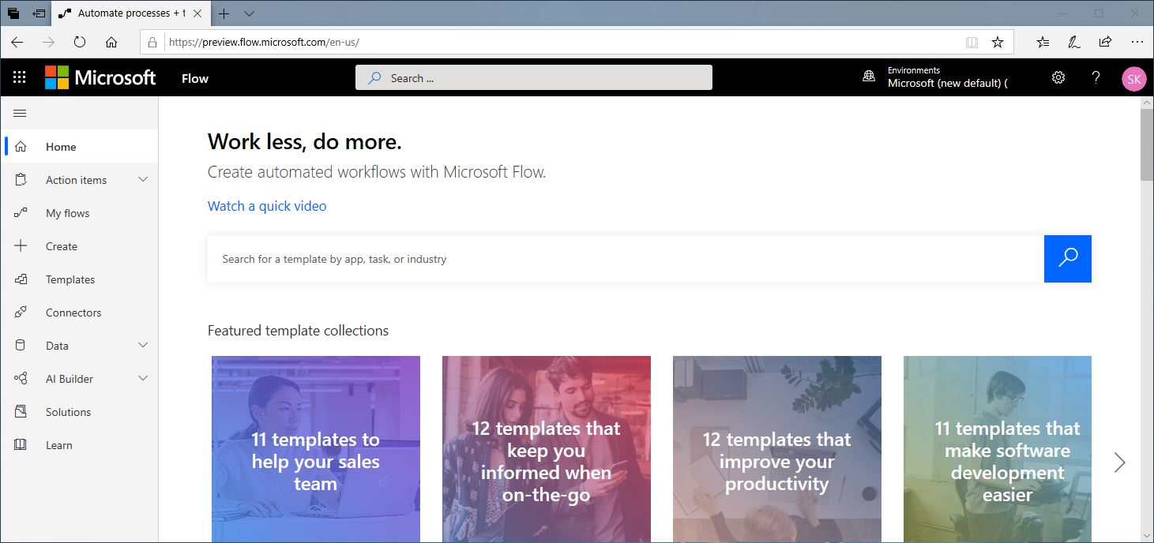
A brief tour of Power Automate
Flows can be created from: Make.powerapps.com
Notes:
Let's jump into Power Automate, and we'll show you around. We have tons of information for you to learn about how to use Power Automate.
When you sign in to Power Automate, you'll find these menus:
Action items, where you can manage approvals and business process flows.
My flows, where your flows reside.
Create, where you start a new flow.
Templates, where you can take a look at some of the most popular templates. These should give you some great ideas for flows you want to try.
Connectors, where you can connect from one service to another.
Data, where you can access tables, connections, custom connectors and gateways.
Solutions, where you can manage your solutions.
Learn, where you can find information that will help you quickly ramp up on Power Automate.
For now, let's focus on the ? menu next to your login, which has these options:
Documentation is where our advanced topics reside. If you want to really understand a feature or function, you can do a deep dive here to figure things out.
Learn has learning paths to guide you through using Power Automate, all the way from beginning techniques to advanced scenarios.
Support is a great landing place to find help.
Roadmap is where you can get a glimpse into what will be made in the next product update.
Community is a place to plug into and find out how other people use Power Automate.
Give Feedback taps into a community of power users, and is where you can send comments and questions to developers and other experienced users.
Blog keeps you up to date about the most recent developments and releases in the Power Automate ecosystem.
Pricing can help you choose the right plan for you or your business.

Slide 7
Power Automate screen
When you sign into Power Automate, you’ll find these menus:
Action items: Where you manage approvals and business process flows
My flows: Where your flows reside
Create: Where you start a new flow
Templates: Where you can look at popular templates
Connectors: Where you can connect from one service to another
Data: Where you can access tables, connections, custom connectors and gateways
Solutions: Where you can manage your solutions
Notes:
You can use Power Automate to automate workflows between your favorite applications and services, sync files, get notifications, collect data, and much more.
For example, you can automate these tasks:
Instantly respond to high-priority notifications or emails.
Capture, track, and follow up with new sales leads.
Copy all email attachments to your OneDrive for Business account.
Collect data about your business, and share that information with your team.
Automate approval workflows.
A common use of Power Automate is to receive notifications. For example, you can instantly receive an email or a push notification on your phone whenever a sales lead is added to Dynamics 365 or Salesforce.

Slide 8
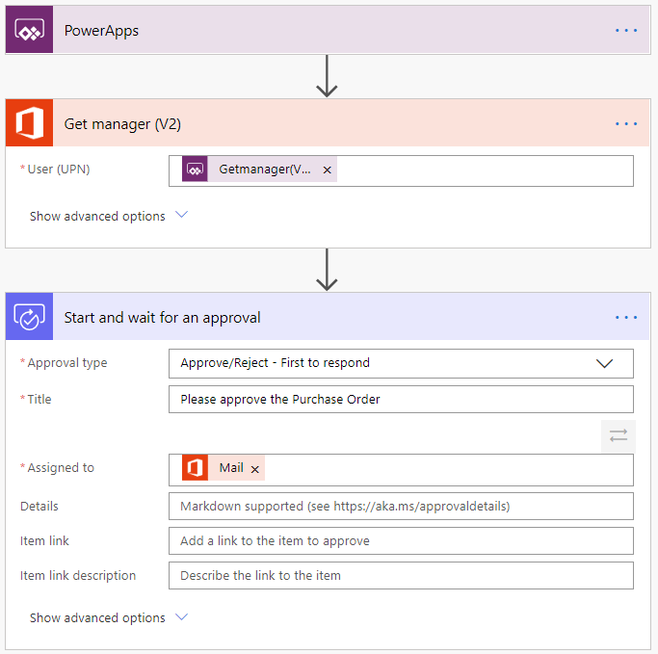
Example: Purchase order approval
Notes:
Approvals are a great process to build in Power Automate. They are often defined yet manual. Check out the following scenario for an example:
A user starts the process by going into a Power Apps app and creating a purchase order request. Once they submit the request, the information is sent to a Power Automate flow.
The flow can be built to evaluate the request and then route the request based on criteria such as submitting user and request amount. The first action could be to send the request to the user's manager. The manager could be automatically retrieved from Azure AD, avoiding prompting for duplicate information.
Here is the starting point of the flow.

Slide 9
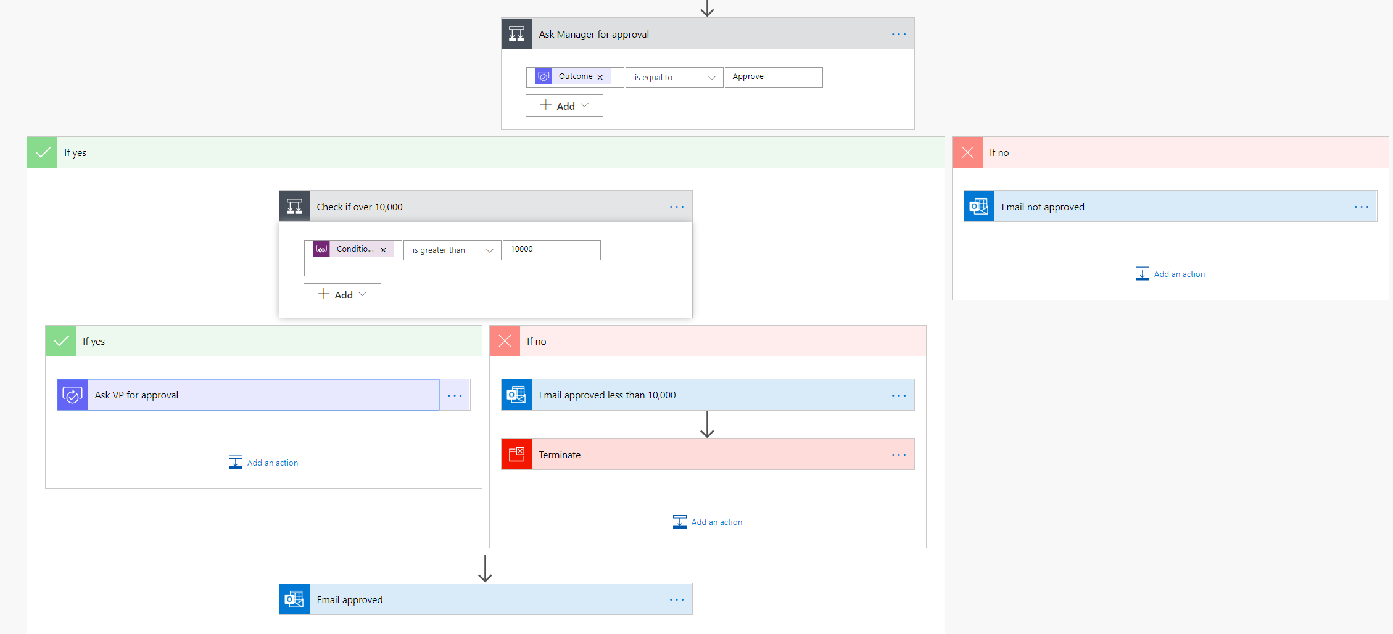
Example: Purchase order approval
Notes:
After the manager receives the approval and approves, the flow can then provide conditional logic. Typically this might be something like if the purchase order request is greater than $10,000 send it to VP if not then automatically approve the purchase order.
Here is an example of what this flow may look like.

Slide 10
Types of Power Automate flows
Event driven flows:
Flows built of a trigger to execute one or more actions
Business process flows:
Flows built to augment the experience when using Model-driven apps and Microsoft Dataverse
UI flows:
Robotic process automation (RPA) flows allow you to row yourself performing actions on your desktop or within a web browser
Notes:
Event driven flows - These are flows that you build with a trigger and then one or more actions. There are a multitude of triggers and actions available, thanks to the existing connectors. You will see these as My flows and Team flows in Power Automate. The only difference between a My flow and a Team flow is ownership. With a My flow you are the sole owner, while a Team flow has more than one owner.
Business process flows - These flows are built to augment the experience when using Model-driven apps and the Microsoft Dataverse. Use these to create a guided experience in your Model-driven apps.
UI flows - These robotic process automation (RPA) flows allow you to row yourself performing actions on your desktop or within a web browser. You can then trigger a flow to perform that process for you. You can also pass data in or get data out of the process, letting you automate even "manual" business processes.

Slide 11
Key concepts
Every flow has two main parts:
A Trigger:
The starting action of the flow such as new email arriving in your inbox or a new item being added to a SharePoint list
One or more Actions:
What you want to happen when a trigger is invoked such as start the action of creating a new file on OneDrive for Business
Notes:
Other examples of actions include sending an email, posting a tweet, and starting an approval.

Slide 12
Demo: Building a flow
Notes:
Use this opportunity to provide students with an overview of the application, and show them how to get to the different components. Show them how to create a Flow.

Slide 13
Exercise: Create your first flow
Follow the exercise in the student manual
Notes:
https://docs.microsoft.com/en-us/learn/modules/get-started-flows/2-create-first-flow

Slide 14
Exercise: Learn to use the Power Automate mobile app
Follow the exercise in the student manual
Notes:
https://docs.microsoft.com/en-us/learn/modules/get-started-flows/3-learn-to-use-flow-mobile-app

Slide 15
Exercise: Receive text and email notifications from flows
Follow the exercise in the student manual
Notes:
https://docs.microsoft.com/en-us/learn/modules/get-started-flows/4-flow-get-notifications

Slide 16
Exercise: Copy files with flow
Follow the exercise in the student manual
Notes:
https://docs.microsoft.com/en-us/learn/modules/get-started-flows/5-flow-copy-files

Slide 17
Exercise: Create recurring flows
Follow the exercise in the student manual
Notes:
https://docs.microsoft.com/en-us/learn/modules/get-started-flows/6-flow-scheduled-flows

Slide 18
Exercise: Send an email when a tweet is posted
Follow the exercise in the student manual
Notes:
https://docs.microsoft.com/en-us/learn/modules/get-started-flows/7-flow-post-tweets

Slide 19
Exercise: Create team flows
Follow the exercise in the student manual
Notes:
https://docs.microsoft.com/en-us/learn/modules/get-started-flows/8-flow-team-flows

Slide 20
Exercise: Troubleshoot flows
Follow the exercise in the student manual
Notes:
https://docs.microsoft.com/en-us/learn/modules/get-started-flows/9-troubleshoot-flows

Slide 21
Use the Admin center to manage environments and data policies in Power Automate

Slide 22
Administering flows
You can create a flow and perform administrative tasks in a browser or, if you download the Power Automate mobile app, on your phone:
Turn flows on or off from wherever you are
See when a flow has failed
Review detailed run history reports
View and filter runs by notification type
Notes:
You can create a flow and perform administrative tasks in a browser or, if you download the Power Automate mobile app, on your phone.
Here are some of the tasks you can perform with the mobile app:
Turn flows on or off from wherever you are.
See when a flow has failed.
Review detailed run history reports.
View and filter runs by notification type.

Slide 23
Administer flows
The Admin center is the central location where tenant admins and environment admins manage an organization’s data policies and environments:
Import and export flows
Share flows
Monitor flows
Notes:
Welcome to the Admin center! The Admin center is the central location where tenant admins and environment admins manage an organization's data policies and environments. Any changes that you make in the Admin center are immediately available to users in the organization.
In this module, you'll learn how to:
Import and export flows.
Share flows.
Monitor flows.

Slide 24
Environments
An environment is a space where you can store, manage, and share your organization’s business data, apps, and flows:
You can create separate environments to group the test and production versions of your apps
You can create separate environments that correspond to specific teams or departments in your company. Each environment holds the relevant data and apps for each team/ department
You can create separate environments for different global branches of your company
You can build all your apps in a single environment
Notes:
An environment is a space where you can store, manage, and share your organization's business data, apps, and flows. It also serves as a container to separate apps that might have different roles, security requirements, or target audiences.
The way that you use environments depends on your organization and the apps that you're trying to build. Here are some examples:
You can create separate environments to group the test and production versions of your apps.
You can create separate environments that correspond to specific teams or departments in your company. Each environment holds the relevant data and apps for each team/department.
You can create separate environments for different global branches of your company.
You can build all your apps in a single environment.

Slide 25
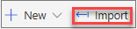
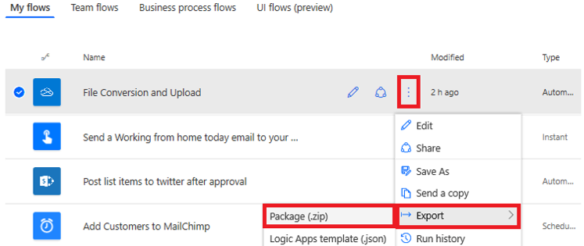
Export a flow
Import a flow:
After a flow has been exported, it can be imported by anyone that you send the zip file to.

Slide 26
Exercise: Export and import flows
Follow the exercise in the student manual
Notes:
https://docs.microsoft.com/en-us/learn/modules/administer-flows/2-flow-export-import

Slide 27
Exercise: Distribute button flows
Follow the exercise in the student manual
Notes:
https://docs.microsoft.com/en-us/learn/modules/administer-flows/3-share-flows

Slide 28
Introduction to business process flows

Slide 29
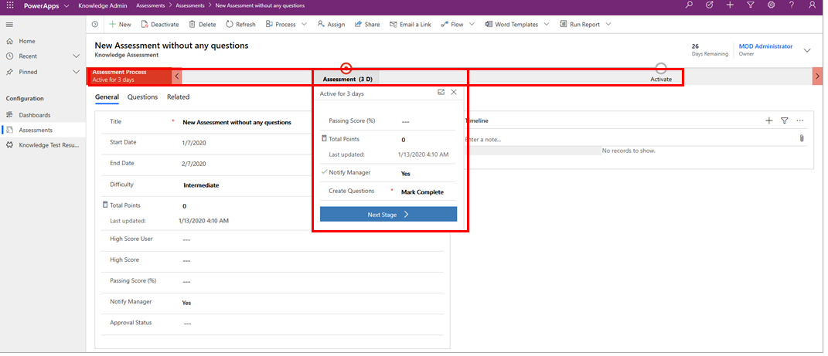
Introduction to business process flows
A business process flow is a series of ordered work steps that a user completes within a business process
Notes:
A business process flow is a series of ordered work steps that a user completes within a business process. In Microsoft Power Automate, a business process flow is composed of a series of discrete stages that leads a user along a path toward process completion. Each stage contains one or more columns (called data steps) that you should complete before proceeding to the next stage in the business process flow.
A business process flow visually guides a user through stages within a process and shows progress toward process completion. A user can also see which stages that they have completed and which stages that they still need to complete within an instance of a process.
Business process flows can be configured to require users to enter information into certain columns (data steps) before completing the stage and, if needed, you can also allow users to jump stages. All data that is collected while you are completing a business process flow is stored in one or more tables in Dataverse.
The following illustration shows a simple business process flow with two stages for adding questions to a survey. The business process flow is shown as a component of a model-driven solution in Power Apps.
Business process flows are created and managed by using Power Automate, and they are available for out-of-the-box tables and for your own custom tables. Microsoft has many prebuilt business process flows, or you can create your own. Additionally, a table can have none, one, or many business process flows associated with it. Business process flows are customizable to fit many organizational needs.
[!TIP] Business process flows are meant to guide users through steps that are required to complete a business process. You must have a valid Power Apps Dynamics 365 license or a valid Power Apps license to create or use a business process flow.

Slide 30
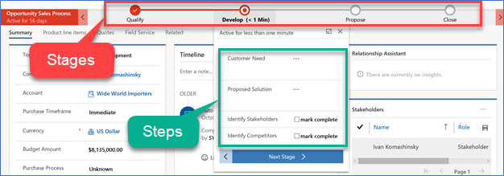
Business process flows
A guide, roadmap,
recipe, …
Stages and steps
Stage gating
Conditional branching
Include multiple tables
Switch at any time
Role tailored
Automation and Developer APIs
Notes:
Spend as much time as necessary making sure the audience has an understanding of the basics of Business Process Flows

Slide 31
When to use business process flows
Want to create automated business processes with Dynamics 365 Solutions
Want a simple visual guide to help users complete a process
Want to use out-of-the-box business process flows
Have a Dynamics 365 license and want to create automated business processes with Dataverse
Notes:
Knowing when to use a business process flow or a regular Power Automate flow to automate a processes or task can be difficult. The following guidelines can help you decide if you should use a business process flow or a standard Power Automate flow.
Use a business process flow if you:
Want to create automated business processes with Dynamics 365 Solutions.
Want a simple visual guide to help users complete a process.
Want to use out-of-the-box business process flows.
Have a Dynamics 365 license and want to create automated business processes with Dataverse.

Slide 32
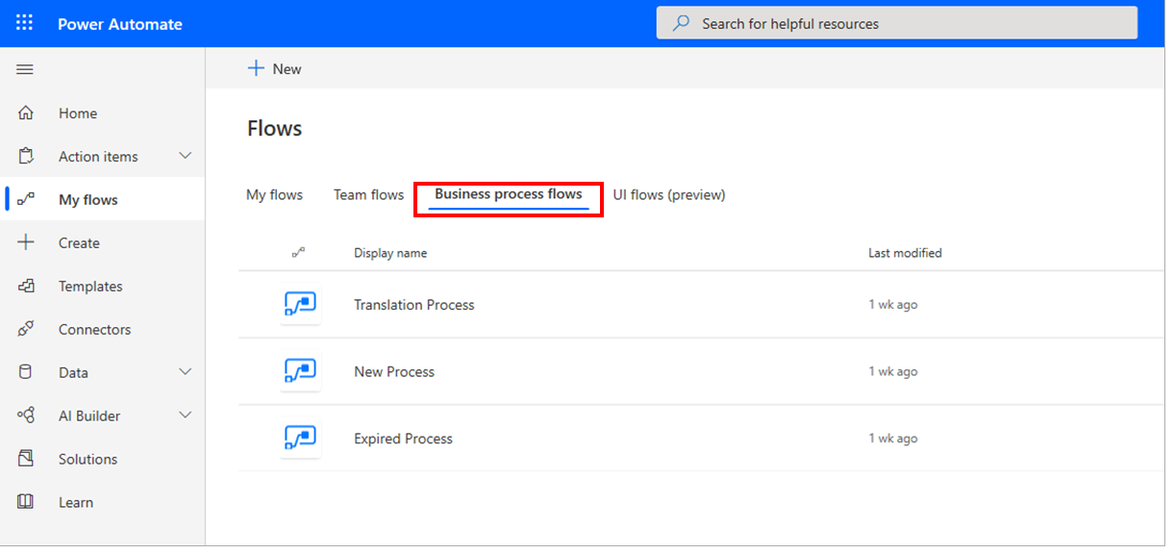
How is it different from a Power Automate Flow?
Business process flows offer the following benefits:
Improved outcomes
Consistent stages and work steps across all instances of the process
Improved data collection and reporting
Decreased time to complete the process
Predictable outcomes
Notes:
A business process flow is a visual guide that is meant to help users complete a business process by using a set of predefined stages. Users are not limited on how long they run a business process or how long they have a stage open. All data that is associated with the business process flow can only be stored in one or more tables in Dataverse, and you cannot associate a business process flow with another data source behind it.
Dataverse has many different out-of-the-box business process flows that you can use in its current state or modified to fit your needs.
A Power Automate flow does not have any visual components like a business process flow. Power Automate flows can be configured to work with many different data sources and a flow can connect to many different data sources within the same flow. A flow can be configured to time out if it is not completed in a certain time and can be triggered to move between steps based on data or user interaction. Flows support complex logic and looping and a Power Automate flow can call another Power Automate flow as needed.
Business process flows allow organizations to quickly standardize how processes are completed and what data is collected at each stage. Business process flows support logical branching so they can be used to standardize many common business processes within an organization.
Business process flows offer the following benefits:
Improved outcomes
Consistent stages and work steps across all instances of the process
Improved data collection and reporting
Decreased time to complete the process
Predictable outcomes
Improved outcomes
Consistent stages and work steps across all instances of the process
Improved data collection and reporting
Decreased time to complete the process
Predictable outcomes
Business process flows are simple to set up and administer. Business process users who are close to business operations and processes can create new business process flows or modify out-of-the-box business process flows by using Power Automate.
Business process flows can be customized based on security roles, allowing access to the appropriate stages and steps based on a security role. Finally, the process of each instance of a business process flow can be monitored, and the data from the process flow can be used in Power BI dashboards and reporting for simplified administration.
Business process flows are deeply integrated with the Microsoft Power Platform. They are created, customized, and managed by using Power Automate. You can manage or create new business process flows by launching Power Automate and selecting Business process flows under My Flows in Power Automate, as shown in the following image.

Slide 33
When to use
Business Process Flow
Power Automate Flow
Want to create automated business processes with CDS Solutions
Start based on a predefined time interval or after X minutes, hours, or days of some action or event
Want a simple visual guide to help users complete a process
Want to trigger a flow based on data outside of Dataverse (SharePoint, for example)
Want to use out-of-the-box business process flows
Do not want to store data that is captured in the flow in Dataverse
Have a Dynamics 365 license and want to create automated business processes with Dataverse
Want to push notifications outside of Outlook (SMS or Gmail, for example)
Want to use and create workflows with only an Office 365 license
Notes:
A business process flow is a visual guide that is meant to help users complete a business process by using a set of predefined stages. Users are not limited on how long they run a business process or how long they have a stage open. All data that is associated with the business process flow can only be stored in one or more tables in Dataverse, and you cannot associate a business process flow with another data source behind it.
Dataverse has many different out-of-the-box business process flows that you can use in its current state or modified to fit your needs.
A Power Automate flow does not have any visual components like a business process flow. Power Automate flows can be configured to work with many different data sources and a flow can connect to many different data sources within the same flow. A flow can be configured to time out if it is not completed in a certain time and can be triggered to move between steps based on data or user interaction. Flows support complex logic and looping and a Power Automate flow can call another Power Automate flow as needed.
Business process flows allow organizations to quickly standardize how processes are completed and what data is collected at each stage. Business process flows support logical branching so they can be used to standardize many common business processes within an organization.
Business process flows offer the following benefits:
Improved outcomes
Consistent stages and work steps across all instances of the process
Improved data collection and reporting
Decreased time to complete the process
Predictable outcomes
Improved outcomes
Consistent stages and work steps across all instances of the process
Improved data collection and reporting
Decreased time to complete the process
Predictable outcomes
Business process flows are simple to set up and administer. Business process users who are close to business operations and processes can create new business process flows or modify out-of-the-box business process flows by using Power Automate.
Business process flows can be customized based on security roles, allowing access to the appropriate stages and steps based on a security role. Finally, the process of each instance of a business process flow can be monitored, and the data from the process flow can be used in Power BI dashboards and reporting for simplified administration.
Business process flows are deeply integrated with the Microsoft Power Platform. They are created, customized, and managed by using Power Automate. You can manage or create new business process flows by launching Power Automate and selecting Business process flows under My Flows in Power Automate, as shown in the following image.

Slide 34
Create an immersive business process flow

Slide 35
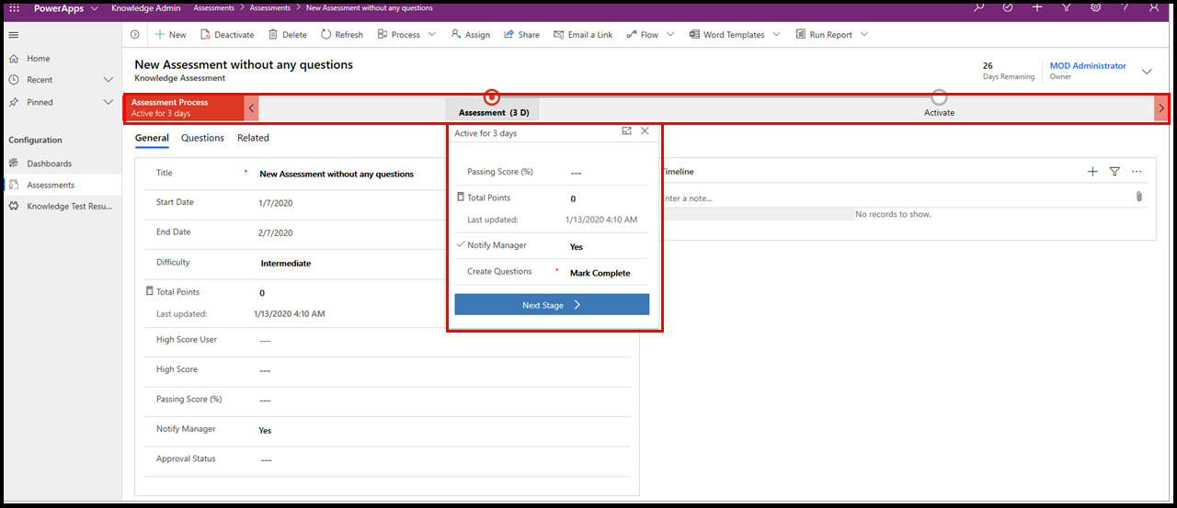
Types of business process flows
Embedded: Embedded within a model-driven app
Immersive: Stand-alone solution
Notes:
Business process flows are available in two different varieties: embedded within a model-driven app and as a stand-alone solution called an immersive business process flow. You should examine the differences between each before learning how to create an immersive business process flow.
Embedded business process flows are visual representations of a series of work steps within an end-to-end process. They always appear along the top of a model-driven app in their own control, as shown in the following image.

Slide 36
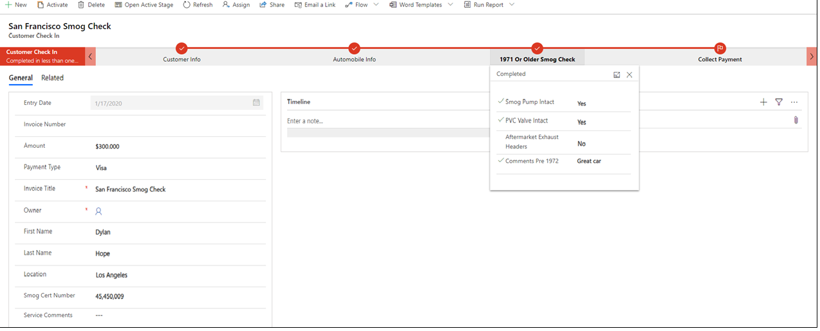
Launching business process flows
Can be launched as a component of a model-driven Power App or a stand-alone application within Power Automate (called an immersive business process flow), as shown in the following image
Notes:
You can launch the new business process flows as a component of a model-driven Power App or a stand-alone application within Power Automate (called an immersive business process flow), as shown in the following image.
As mentioned previously, all data that is associated with a business process flow is stored in one or more Dataverse tables (custom or standard). You could launch an instant Power Automate flow in conjunction with a business process flow to store data outside of Dataverse if needed. Additionally, you can create Power BI dashboards from the data that was collected within the business process flow.
Business process flows are deeply integrated within Power Platform and offer powerful ways to improve how you manage common business processes.

Slide 37
Exercise: Create an immersive business process flow
Follow the exercise in the student manual
Notes:
Alternative link
https://docs.microsoft.com/en-us/learn/modules/create-immersive-flow/2-immersive-flow

Slide 38
Exercise: Run the business process flow and view data
Follow the exercise in the student manual
Notes:
Alternative link
https://docs.microsoft.com/en-us/learn/modules/create-immersive-flow/3-run-flow

Slide 39
Introduction to Power Automate security and governance

Slide 40
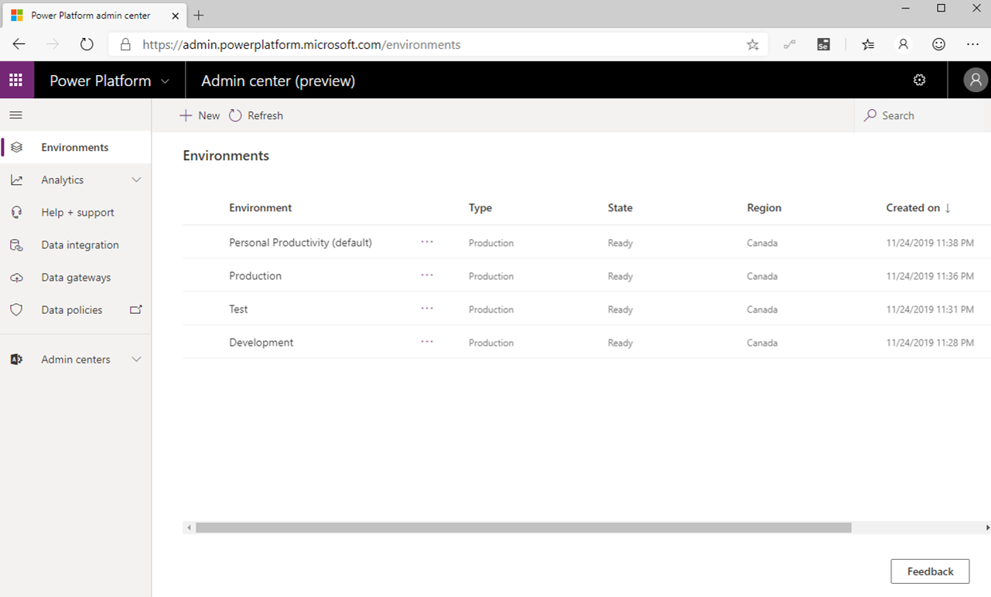
Identify Power Platform environments
Environments are an important consideration when you are trying to help secure and govern Power Apps and Power Automate usage
Notes:
Environments are an important consideration when you are trying to help secure and govern Power Apps and Power Automate usage. Environments act as a security container for apps and flows to run within. Every flow must be assigned to an environment. Every licensed user belongs to the default environment.
Additional environments can be provisioned where opt-in access is possible. A strategy that some organizations adopt includes renaming the default environmentto be called Personal Productivity, which implies permission to build flows that improve their own productivity.
Organizations can subsequently create additional environments for development, testing, and production purposes. Using this strategy might also align flow creation with existing IT change management requirements.
By default, anyone can create environments, but administrators can also control who can create and manage environments in the Power Platform Admin centerand limit it to a set of administrators.
When creating an environment, organizations can choose which region they want their environment to reside in. This approach is important because it allows organizations to store data closer to actual users and to maintain and meet compliance requirements for their geography. Regions already available to store data include Asia, Australia, Canada, Europe, France, India, Japan, South America, United Kingdom, United States, and US Government (GCC).
Regions are also important when it comes to Admin Analytics because the Power Platform Analytics feature isolates analytics through environments. The telemetry that is generated in one region is not allowed to leave that region. For administrators to view analytics, they need to select an environment first before they can view telemetry.

Slide 41
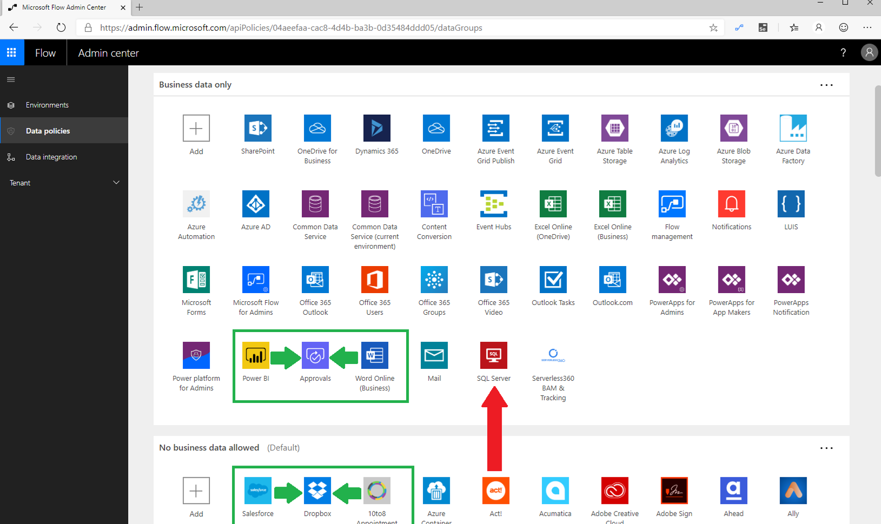
Data Loss Prevention policies
Data Loss Prevention (DLP) policies allow organizations to construct rules that permit and prevent connectors from communicating with each other within the same flow
Notes:
Data Loss Prevention (DLP) policies allow organizations to construct rules that permit and prevent connectors from communicating with each other within the same flow. Microsoft accomplishes this task by establishing two data groups: Business data only and No business data allowed. The intent of these two data groups is to put connectors that have the same data profile in the same data group. Grouping connectors means that they can communicate with each other within the same data group but are not able to communicate across data groups.
To illustrate this concept, consider the following scenario where connectors have been distributed across the two data groups. You want to build a flow that includes the Microsoft Word Online, Approvals, and Power BI connectors. Because all of these connectors belong to the Business data only data group, you can confidently create and run this flow.
Similarly, in the No business data allowed data group, you can combine the Salesforce, Dropbox, and 10to8 Appointment connectors within the same flow because they all belong to the same data group. However, you cannot create a flow that includes the SQL Server connector and Act! connector because they belong to different data groups. If you want to create a flow that included these two connectors, you will need to move one of the connectors into the other data group.

Slide 42
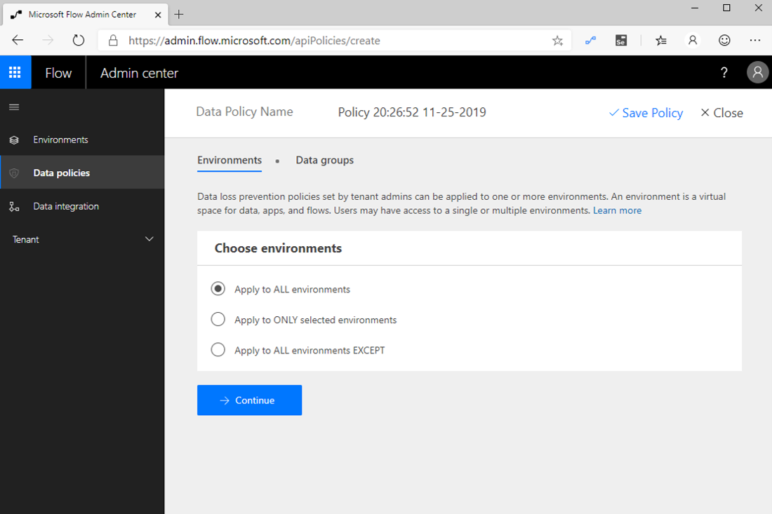
Data Loss Prevention policies
When a DLP author selects Apply to ALL environments, this setting also ensures that new environments have this DLP policy applied
Notes:
Additionally, you can specify one data group to be the default data group. Beside the name of the default data group is the (Default) label appended. To change the default data group, select the ellipsis (...) in the upper-right corner of the data group.
The default data group is significant because it becomes the data group that all new connectors are added to. For example, if Microsoft deploys a new connector to the Power Automate service, that connector will be added to the default data group. This behavior is also true for custom connectors that are deployed to an environment.
DLP policies can belong to two different scopes: environment and tenant. An environment-scoped DLP policy only applies to that specific environment, whereas a tenant-scoped DLP policy applies to all environments in that tenant. When creating a new DLP policy, policy authors have a few options that they can choose from, including the ability to Apply to ALL environments (tenant), Apply to ONLY selected environments, and Apply to All environments EXCEPT.
When a DLP author selects Apply to ALL environments, this setting also ensures that new environments have this DLP policy applied.
Environments can have multiple DLP policies applied, which provides for more governance scenarios to be implemented. However, when multiple DLP policies have been implemented, the most restrictive policy is applied. DLP policy layering is discussed further in the Planning module.
Configuring DLP policies depends on an organization's design and cyber security principles. For some organizations, these principles allow for the mixing of business-related connectors with consumer-based services. Other organizations might choose to strictly prevent business-related connectors from connecting with consumer-based services. Organizations should begin by cataloging the business systems that exist within their organization and then creating DLP policies that align with that business mapping. DLP strategies are discussed further in the Implementation recommendations for Power Automate environments module of this learning path.
Organizations should also carefully evaluate which data group they would like to declare as their default data group. Regardless of which data group they designate, administrators should pay attention to new connectors that are being deployed into environments so they can place them into the appropriate data group. How administrators can detect these new connector events is discussed further in the Use templates to enforce governance policies in Power Automate module of this learning path.

Slide 43
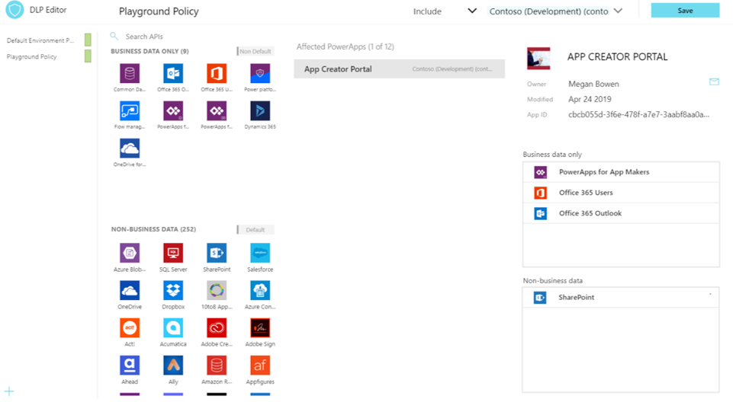
Power Platform Center of Excellence Starter Kit
The Power Platform Center of Excellence (COE) Starter Kit is a set of apps, flows, a custom connector, and a Power BI dashboard that allows organizations to govern their Power Platform environments
Notes:
The Power Platform Center of Excellence (COE) Starter Kit is a set of apps, flows, a custom connector, and a Power BI dashboard that allows organizations to govern their Power Platform environments. The tool is freely available for download on GitHub.
The Starter Kit is a great tool for organizations to increase the visibility of what their makers are doing in their tenant. Naturally, this tool immediately applies to two personas: Cyber Security analysts and Organizational Change Management (OCM) interests. Makers that are building applications and services that introduce risk to the organization should be monitored, but makers who are automating workloads within sanctioned systems and services should be empowered and encouraged to expand on their efforts.
The Starter Kit does have some prerequisites, including:
A global tenant admin, Power Platform Service admin, or Dynamics 365 service admin role is required to access the tenant resources.
A Power Apps premium license for accessing Dataverse.
An environment with Dataverse because the Starter Kit solution will need to store metadata about the apps and flows that are detected within an environment.
Power BI Desktop to view the reports and visualizations that highlight app and flow use within the tenant.
A global tenant admin, Power Platform Service admin, or Dynamics 365 service admin role is required to access the tenant resources.
A Power Apps premium license for accessing Dataverse.
An environment with Dataverse because the Starter Kit solution will need to store metadata about the apps and flows that are detected within an environment.
Power BI Desktop to view the reports and visualizations that highlight app and flow use within the tenant.
Within the Starter Kit, administrators will discover the tools and features that are discussed in the following sections.
By using the DLP Editor app, an administrator can explore existing DLP policies and evaluate the impact of moving a connector from one data group to another. If a change to a data group has an impact on an existing app, that will be highlighted in the Affected Power Apps list. Then, an administrator can send an email, through an in-app experience, to the owner of that application and warn them of the upcoming change.
This current, in-product DLP editor experience doesn't provide this type of what-if analysis, so we recommend that you use the DLP Strategy app that comes with the COE Starter Kit when making DLP changes. Using the DLP Strategy app will also help you understand the impact to existing apps when DLP changes are made and help you reduce the chance of unknowingly breaking someone's app.

Slide 44
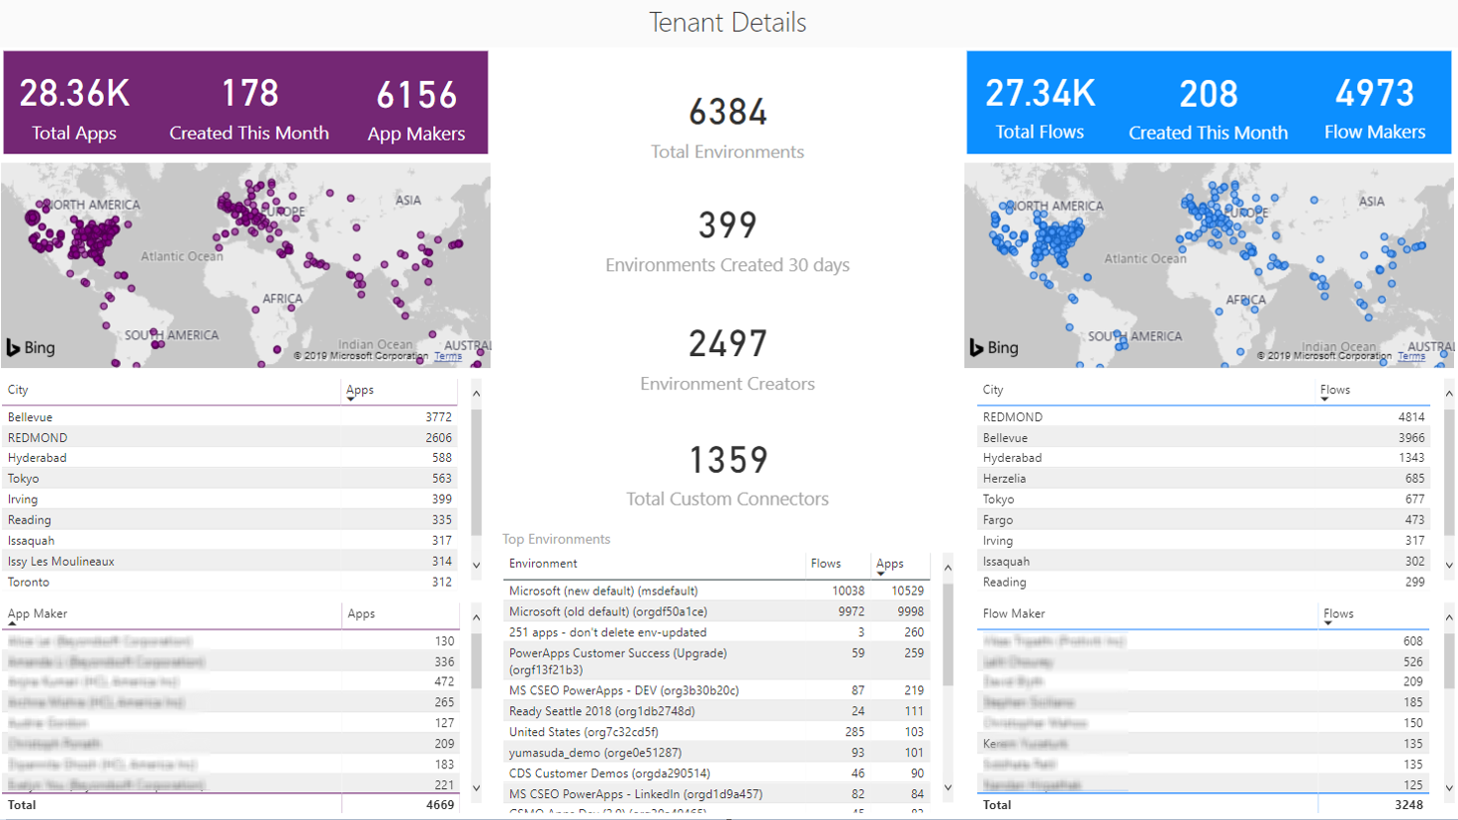
Power Platform Center of Excellence Starter Kit
The Power BI dashboard connects to Starter Kit Dataverse tables and contains tabs that provide the following reports:
Notes:
While Admin Analytics, which is found in the Power Platform Admin center, provides some insight into the use of Power Apps and Power Automate, it does so within the context of an environment. This parameter makes developing a holistic picture of usage difficult. However, using the tools that are provided in the COE Starter Kit brings all these insights together by using Dataverse, a model-driven Power App, and a Power BI dashboard. These assets, plus the inclusion of flows that will sync data from Office 365 Security and Compliance logs and through the Power Platform management connectors into Dataverse tables, provide the greatest level of visibility for administrators.
The Power BI dashboard connects to Starter Kit Dataverse tables and contains tabs that provide the following reports:

Slide 45

Power Platform Center of Excellence Starter Kit
Connections – Displays the number of connections that have been established, by connector
Notes:
Overview - Includes the total number of apps and flows that have been created, including a breakdown based on the maker's location and the number of apps/flows that they have created.
Environments - Highlights the number of environments that have been created and includes the type of environment (Default, Production, Sandbox, Trial), and then identifies the creators of the environments and when the environment was created.
Apps - Provides insights into the usage of apps, including the number of sessions and users that the app has been shared with. This report also breaks down usage by department by pivoting data based on the department that has been specified inside of a user's Office 365 profile.
App detail - Examines the specifics of the app, including the connection type and when the app was last published.
Flows - Displays a flow creation trend that will break down when flows were created. This report will also pivot data based on the user's department and includes a breakdown of the flows that were created by environment.
Custom Connectors - Lists all the custom connectors that exist within a tenant. This report also lists the users that created the connectors and then trends the month that they were created in.
Makers - Identifies all the makers within the environment and identifies how many apps and flows they have built. A slicer exists that allows a consumer of this report to filter based on the maker's department.
Connections - Displays the number of connections that have been established, by connector. This report provides great insight into the popularity of specific connectors within your tenant.

Slide 46
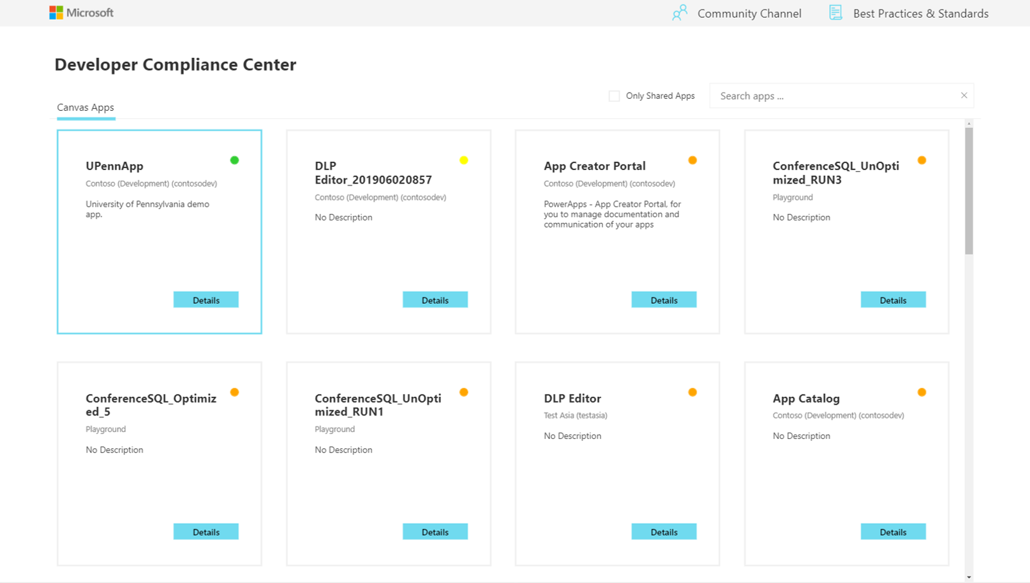
Power Platform Center of Excellence Starter Kit
The main purpose of the Sample App Audit process is to demonstrate how an admin could identify overshared or often used resources and gather further information, like business justification and business impact of an outage, for those apps
Notes:
The main purpose of the Sample App Audit process is to demonstrate how an admin could identify overshared or often used resources and gather further information, like business justification and business impact of an outage, for those apps. Having a platform that provides democratized access to technology is only useful if people don't create many redundant or low-value applications. Situations might also occur where people create temporary applications for proof-of-concept purposes. These apps can clutter an environment if they are not cleaned up. Within the COE Starter Kit, app makers can be prompted to attest their application to ensure that it addresses business justification requirements. If the application doesn't address these requirements, makers can have their application removed from the environment.

Slide 47
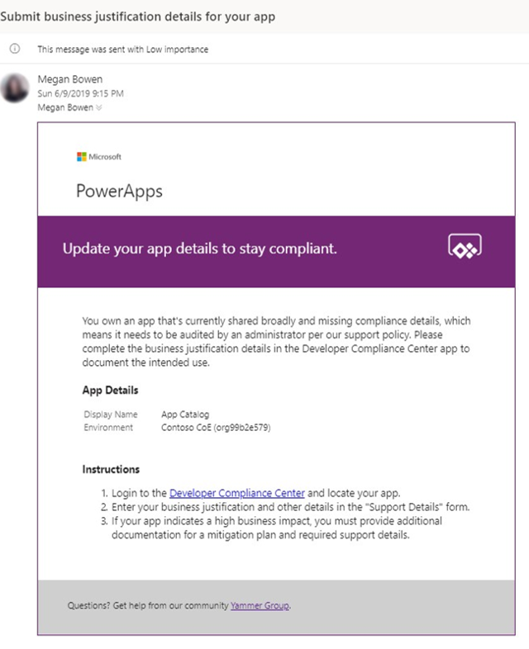
Power Platform Center of Excellence Starter Kit
Administrating access to applications can be done by the Owner of the application
Notes:
The App Catalog application acts as a catalog that helps with discoverability of apps. Users can explore featured apps and browse apps by category. The app catalog can be a great entry point to launch apps for end users and makers can explore to see if an application already exists before they create another app that provides similar functionality. An Admin decides which apps are featured in the App Catalog by completing the App Audit process. After an app has been approved by the App Audit process, these apps can be featured in the app catalog.
Administrating access to applications can be done by the Owner of the application. However, circumstances might occur where you want an administrator to provide access. By using the Set Owner app, you can allow for this situation by selecting an app, adding users, and then indicating whether they should be able to view the app or edit the app.

Slide 48
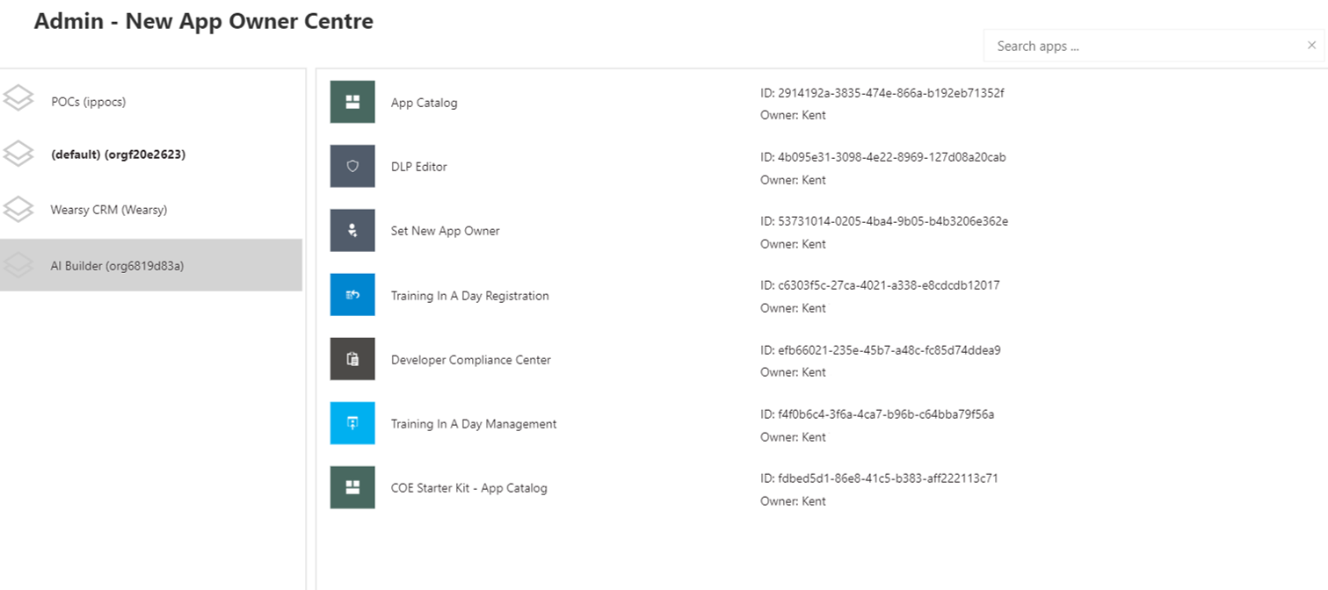
Power Platform Center of Excellence Starter Kit
Detecting when a maker has created their first app or flow and sending them some useful information to accelerate their journey will immediately imply that these tools are the ones that they are permitted to use
Notes:
Power Apps and Power Automate can be discovered virally within an organization's tenant through the Office 365 portal. Makers might be confused about whether they are allowed to use these tools or not.
Detecting when a maker has created their first app or flow and sending them some useful information to accelerate their journey will immediately imply that these tools are the ones that they are permitted to use. Now, they will have a list of resources that can ease their transition into using these tools.

Slide 49
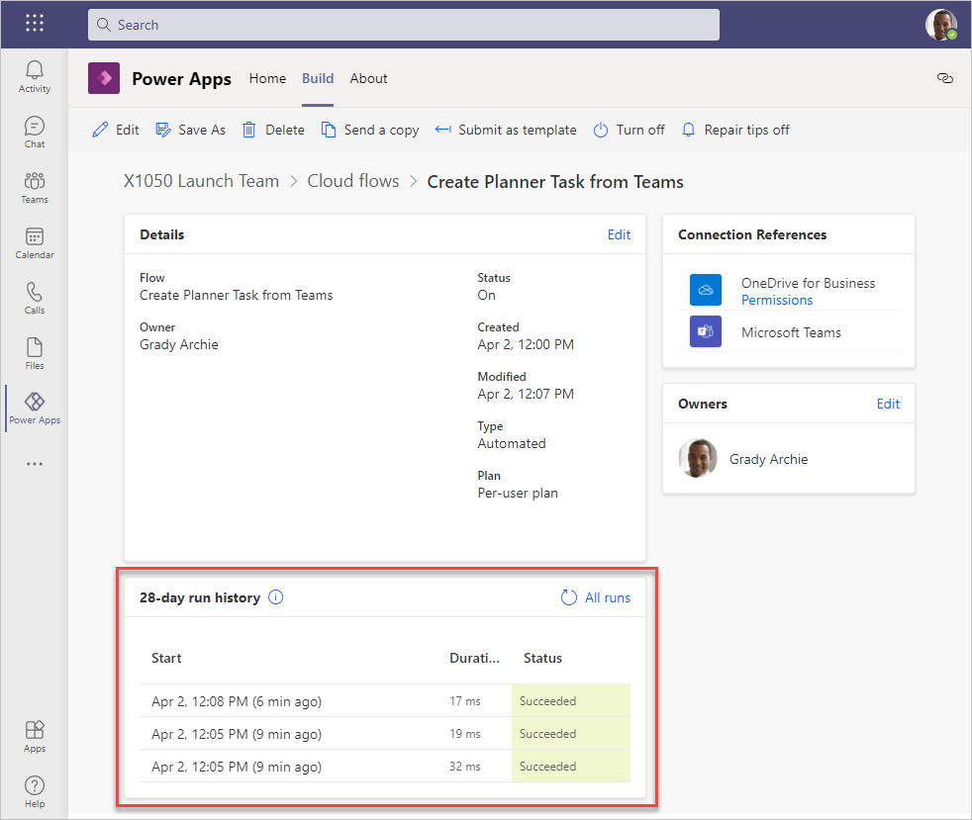
Build your first workflow with Power Automate and Dataverse for Teams
Notes:
Please follow the steps in the learning path:
https://docs.microsoft.com/en-us/learn/modules/build-first-workflow/

